Slide 1

Informed Search
Uninformed searches
  asan
  lakin böyük axtarış ağacının əksər hallarında çox səmərəsiz olur.
Informed searches
  axtarış ağacını kiçik birinə endirmək üçün problemə aid məlumatlardan istifadə edir.
    vaxt və yaddaş problemlərini həll edir.

Slide 2
Informed (Heuristic) Search
Best-first search
  Qiymətləndirmə funksiyasından istifadə edir, f(n)
    Qovşaqların(node) genişləndirilməsinin arzuolunanlığını müəyyən etmək, sifariş vermək.
  Qovşaqların genişləndirilməsi qaydası vacibdir.
    axtarış ağacının ölçüsünə görə
    → daha az məsafə(space), daha sürətli

Slide 3
Best-first search
Every node is then
  attached with a value stating its goodness
The nodes in the queue are arranged
  in the order that the best one is placed first
However this order doesn't guarantee
  the node to expand is really the best
The node only appears to be best
  because, in reality, the evaluation is not omniscient

Slide 4
Best-first search
The path cost g is one of the example
  However, it doesn't direct the search toward the goal
Heuristic function h(n) is required
  Estimate cost of the cheapest path
    from node n to a goal state
  Expand the node closest to the goal
    = Expand the node with least cost
  If n is a goal state, h(n) = 0

Slide 5
Greedy best-first search
Tries to expand the node
  closest to the goal
  because it’s likely to lead to a solution quickly
Just evaluates the node n by
  heuristic function: f(n) = h(n)
E.g., SLD – Straight Line Distance
  h_{SLD}

Slide 6
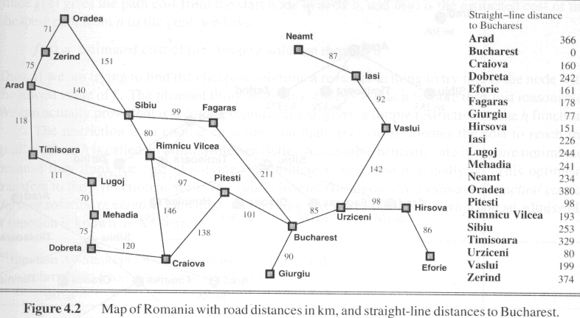

Slide 7
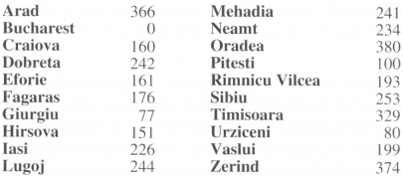
Greedy best-first search
Goal is Bucharest
Initial state is Arad
  h_{SLD} cannot be computed from the problem itself
  only obtainable from some amount of experience

Slide 8
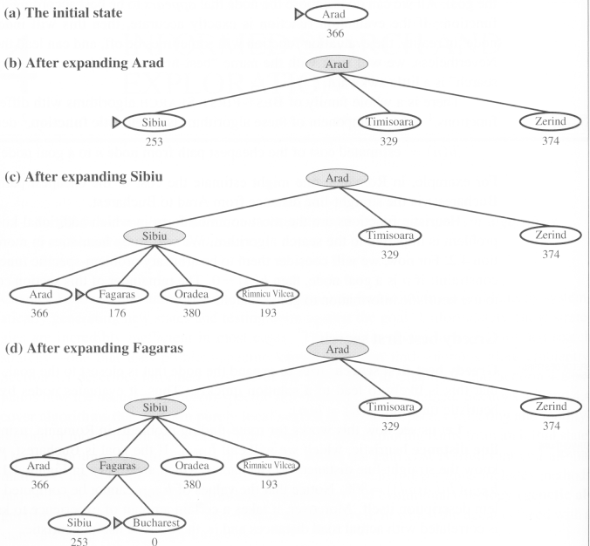

Slide 9
Greedy best-first search
It is good ideally
  but poor practically
  since we cannot make sure a heuristic is good
Also, it just depends on estimates on future cost

Slide 10
Analysis of greedy search
Similar to depth-first search
  not optimal
  incomplete
  suffers from the problem of repeated states
    causing the solution never be found
  The time and space complexities
    depends on the quality of h

Slide 11
Properties of greedy best-first search
Complete? No – can get stuck in loops, e.g., Iasi → Neamt → Iasi → Neamt →
Time? O(bm), but a good heuristic can give dramatic improvement
Space? O(bm) -- keeps all nodes in memory
Optimal? No

Slide 12
A* search
The most well-known best-first search
  evaluates nodes by combining
    path cost g(n) and heuristic h(n)
    f(n) = g(n) + h(n)
    g(n) – cheapest known path
    f(n) – cheapest estimated path
Minimizing the total path cost by
  combining uniform-cost search
  and greedy search

Slide 13
A* search
Uniform-cost search
  optimal and complete
  minimizes the cost of the path so far, g(n)
  but can be very inefficient
greedy search + uniform-cost search
  evaluation function is f(n) = g(n) + h(n)
  [evaluated so far + estimated future]
  f(n) = estimated cost of the cheapest solution through n

Slide 14
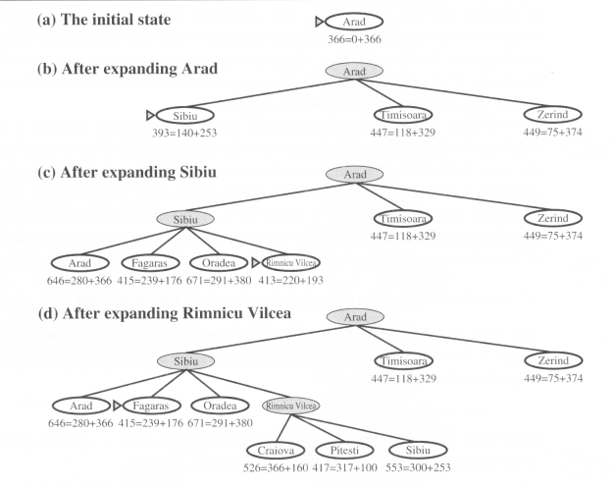

Slide 15
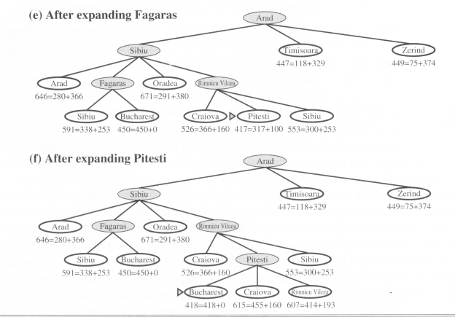

Slide 16
Analysis of A* search
A* search is
  complete and optimal
  time and space complexities are reasonable
But optimality can only be assured when
  h(n) is admissible
  h(n) never overestimates the cost to reach the goal
    we can underestimate
  h_{SLD}, overestimate?

Slide 17
Optimality of A*
A* has the following properties:
The tree-search version of A* is optimal if h(n) is admissible, while the graph version is optimal if h(n) is consistent.
* If h(n) is consistent then the values of f(n) along any path are nondecreasing.

Slide 18
Admissible heuristics
A heuristic h(n) is admissible if for every node n,
h(n) ≤ h*(n), where h*(n) is the true cost to reach the goal state from n.
An admissible heuristic never overestimates the cost to reach the goal, i.e., it is optimistic
Example: hSLD(n) (never overestimates the actual road distance)
Theorem: If h(n) is admissible, A* using TREE-SEARCH is optimal

Slide 19
Memory bounded search
Memory
  is another issue besides the time constraint
  even more important than time
    because a solution cannot be found if not enough memory is available
  A solution can still be found
    even though a long time is needed

Slide 20
Iterative deepening A* search
IDA*
  = Iterative deepening (ID) + A*
  As ID effectively reduces memory constraints
  complete
  and optimal
    because it is indeed A*
  IDA* uses f-cost(g+h) for cutoff
    rather than depth
    the cutoff value is the smallest f-cost of any node
      that exceeded the cutoff value on the previous iteration

Slide 21
RBFS
Recursive best-first search
  similar to depth-first search
  which goes recursively in depth
  except RBFS keeps track of f-value of the best alternative path available from any ancestor of the current node.
It remembers the best f-value
  in the forgotten subtrees
  if necessary, re-expand the nodes

Slide 22
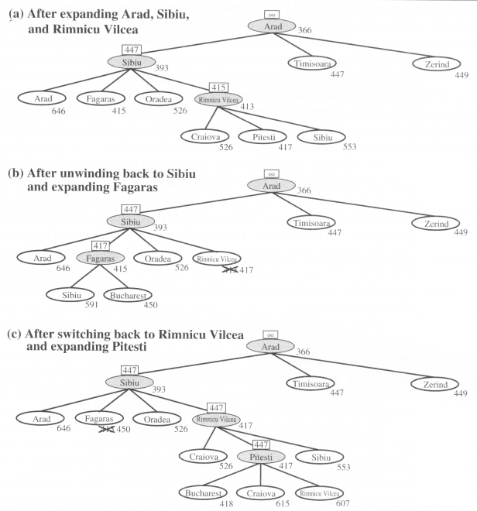

Slide 23
RBFS
optimal
  if h(n) is admissible
  space complexity is: O(bd)
IDA* and RBFS suffer from
  using too little memory
  just keep track of f-cost and some information
Even if more memory were available,
  IDA* and RBFS cannot make use of them

Slide 24
Simplified memory A* search
Weakness of IDA* and RBFS
  only keeps a simple number: f-cost limit
  This may be trapped by repeated states
IDA* is modified to SMA*
  the current path is checked for repeated states
  but unable to avoid repeated states generated by alternative paths
SMA* uses a history of nodes to avoid repeated states

Slide 25
Simplified memory A* search
SMA* has the following properties:
  utilize whatever memory is made available to it
  avoids repeated states as far as its memory allows, by deletion
  complete if the available memory
    is sufficient to store the shallowest solution path
  optimal if enough memory
    is available to store the shallowest optimal solution path

Slide 26
Simplified memory A* search
  Otherwise, it returns the best solution that
    can be reached with the available memory
  When enough memory is available for the entire search tree
    the search is optimally efficient
When SMA* has no memory left
  it drops a node from the queue (tree) that is unpromising (seems to fail)

Slide 27
Simplified memory A* search
To avoid re-exploring, similar to RBFS,
  it keeps information in the ancestor nodes
    about quality of the best path in the forgotten subtree
If all other paths have been shown
  to be worse than the path it has forgotten
  Then it regenerates the forgotten subtree
SMA* can solve more difficult problems than A* (larger tree)

Slide 28
Simplified memory A* search
However, SMA* has to
  repeatedly regenerate the same nodes for some problem
The problem becomes intractable for SMA*
  even though it would be tractable for A*, with unlimited memory
  (it takes too long time!!!)

Slide 29
Heuristic functions
For the problem of 8-puzzle
  two heuristic functions can be applied
    to cut down the search tree
  h₁ = the number of misplaced tiles
  h₁ is admissible because it never overestimates
    at least h₁ steps to reach the goal.

Slide 30
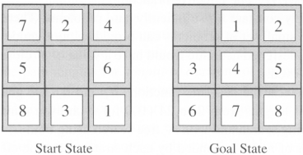
Heuristic functions
  h₂= the sum of distances of the tiles from their goal positions
  This distance is called city block distance or Manhattan distance
    as it counts horizontally and vertically
  h₂ is also admissible, in the example:
    h₂ = 3 + 1 + 2 + 2 + 2 + 3 + 3 + 2 = 18
    True cost = 26

Slide 31
The effect of heuristic accuracy on performance
effective branching factor b*
  can represent the quality of a heuristic
  IF N = the total number of nodes expanded by A* and the solution depth is d,
  THEN b* is the branching factor of the uniform tree
    N = 1 + b* + (b*)² + …. + (b*)^{d}
  N is small if b* tends to 1

Slide 32
The effect of heuristic accuracy on performance
h₂ dominates h₁ if for any node, h₂(n) ≥ h₁(n)
Conclusion:
  always better to use a heuristic function with higher values, as long as it does not overestimate

Slide 33
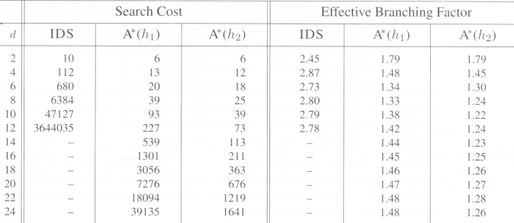
The effect of heuristic accuracy on performance

Slide 34
Inventing admissible heuristic functions
relaxed problem
  A problem with less restriction on the operators
It is often the case that
  the cost of an exact solution to a relaxed problem
    is a good heuristic for the original problem

Slide 35
Inventing admissible heuristic functions
Original problem:
  A tile can move from square A to square B
    if A is horizontally or vertically adjacent to B
    and B is blank
Relaxed problem:
  A tile can move from square A to square B
    if A is horizontally or vertically adjacent to B
  A tile can move from square A to square B
    if B is blank
  A tile can move from square A to square B

Slide 36
Inventing admissible heuristic functions
If one doesn't know the “clearly best” heuristic
  among the h₁, …, h_{m} heuristics
  then set h(n) = max(h₁(n), …, h_{m}(n))
  i.e., let the computer run it
    Determine at run time

Slide 37
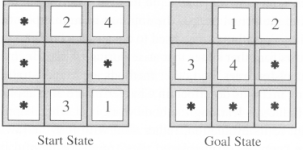
Generating admissible heuristic from subproblem
Admissible heuristic
  can also be derived from the solution cost of a subproblem of a given problem
  getting only 4 tiles into their positions
  cost of the optimal solution of this subproblem
    used as a lower bound

Slide 38
Chapter. 4.

Slide 39
Local search algorithms
So far, we are finding solution paths by searching (Initial state → goal state)
In many problems, however,
  the path to goal is irrelevant to solution
  e.g., 8-queens problem
  solution
    the final configuration
    not the order they are added or modified
Hence we can consider other kinds of method
  Local search

Slide 40
Local search
Just operate on a single current state
  rather than multiple paths
Generally move only to
  neighbors of that state
The paths followed by the search
  are not retained
  hence the method is not systematic

Slide 41
Local search
Two advantages :
  1. uses little memory – a constant amount
    for current state and some information
  2. can find reasonable solutions
    in large or infinite (continuous) state spaces
    where systematic algorithms are unsuitable
Also suitable for
  optimization problems in which the aim is to find the best state according to an objective function

Slide 42
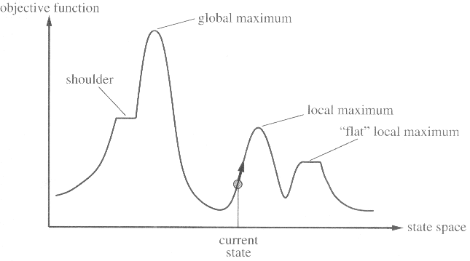
Local search
State space landscape has two axis
  location (defined by states)
  elevation (defined by objective function or by the value of heuristic cost function)

Slide 43
Local search
If elevation corresponds to cost then, the aim is to find lowest valley( global minimum).
If elevation corresponds to an objective function, then the aim is to find highest peak( global maximum).

Slide 44
Local search
A complete local search algorithm
  always finds a goal if one exists
An optimal algorithm
  always finds a global maximum/minimum

Slide 45
Hill-climbing search
(greedy local search)
simply a loop
  It continually moves in the direction of increasing value
  i.e., uphill
No search tree is maintained
The node need only record
  the state
  its evaluation (value, real number)

Slide 46
Hill-climbing search
Evaluation function calculates
  the cost
  a quantity instead of a quality
When there is more than one best successor to choose from
  the algorithm can select among them at random

Slide 47
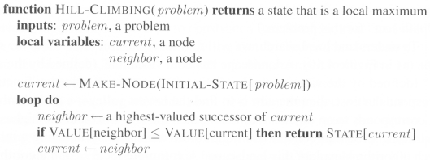
Hill-climbing search

Slide 48
Drawbacks of Hill-climbing search
Hill-climbing is also called
  greedy local search
  grabs a good neighbor state
    without thinking about where to go next.
*** Hill-climbing often gets stuck for the following reasons:-
Local maxima:
  The peaks lower than the highest peak in the state space
  The algorithm stops even though the solution is far from satisfactory

Slide 49
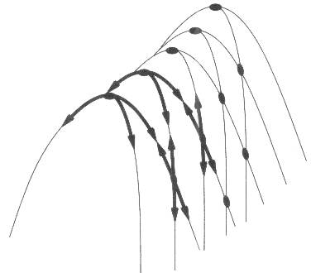
Drawbacks of Hill-climbing search
Ridges
  The grid of states is overlapped on a ridge rising from left to right
  Unless there happen to be operators
    moving directly along the top of the ridge
    the search may oscillate from side to side, making little progress

Slide 50
Drawbacks of Hill-climbing search
Plateaux
  an area of the state space landscape
    where the evaluation function is flat
    shoulder
    impossible to make progress
  Hill-climbing might be unable to
    find its way off the plateau

Slide 51
Solution
Random-restart hill-climbing resolves these problems
  It conducts a series of hill-climbing searches
    from random generated initial states
    the best result found so far is saved from any of the searches
  It can use a fixed number of iterations
  Continue until the best saved result has not been improved
    for a certain number of iterations

Slide 52
Solution
Optimality cannot be ensured
However, a reasonably good solution can usually be found

Slide 53
Simulated annealing
Simulated annealing
  Instead of starting again randomly
  the search can take some downhill steps to leave the local maximum
Annealing is the process of
  gradually cooling a liquid until it freezes
  allowing the downhill steps gradually

Slide 54
Simulated annealing
The best move is not chosen
  instead a random one is chosen
If the move actually results better
  it is always executed
  Otherwise, the algorithm takes the move with a probability less than 1

Slide 55
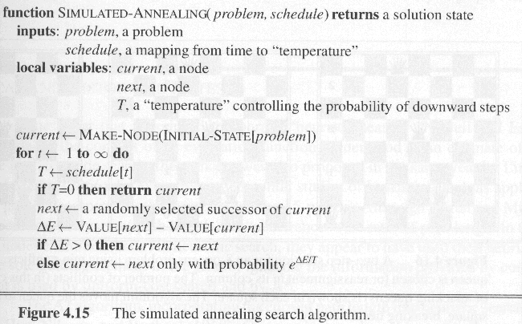
Simulated annealing

Slide 56
Simulated annealing
The probability decreases exponentially
  with the “badness” of the move
  = ΔE
T also affects the probability
Since ΔE ≤ 0, T > 0
  the probability is taken as 0 < e^{ΔE/T} ≤ 1

Slide 57
Simulated annealing
The higher T is
  the more likely the bad move is allowed
  When T is large and ΔE is small (≤ 0)
    ΔE/T is a negative small value → e^{ΔE/T} is close to 1
T becomes smaller and smaller until T = 0
  At that time, SA becomes a normal hill-climbing
  The schedule determines the rate at which T is lowered

Slide 58
Local beam search
Keeping only one current state is no good
Hence local beam search keeps
  k states
  all k states are randomly generated initially
  at each step,
    all successors of k states are generated
  If any one is a goal, then halt!!
  else select the k best successors
    from the complete list and repeat

Slide 59
Local beam search
different from random-restart hill-climbing
  RRHC makes k independent searches
Local beam search will work together
  collaboration
  choosing the best successors
    among those generated together by the k states
Stochastic beam search
  choose k successors at random
  rather than k best successors

Slide 60
Genetic Algorithms
GA
  a variant of stochastic beam search
  successor states are generated by
    combining two parent states
    rather than modifying a single state
  successor state is called an “offspring”
GA works by first making
  a population
  a set of k randomly generated states

Slide 61
Genetic Algorithms
Each state, or individual
  represented as a string over a finite alphabet, e.g., binary or 1 to 8, etc.
The production of next generation of states
  is rated by the evaluation function
  or fitness function
    returns higher values for better states
Next generation is chosen
  based on some probabilities ← fitness function

Slide 62
Genetic Algorithms
Operations for reproduction
  cross-over
    combining two parent states randomly
    cross-over point is randomly chosen from the positions in the string
  mutation
    modifying the state randomly with a small independent probability
Efficiency and effectiveness
  are based on the state representation
  different algorithms

Slide 63
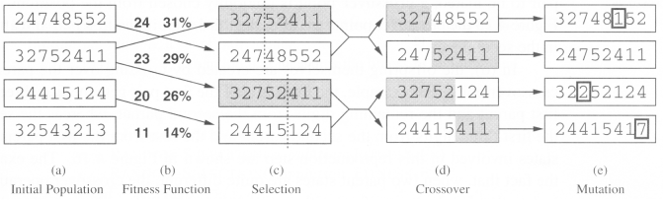
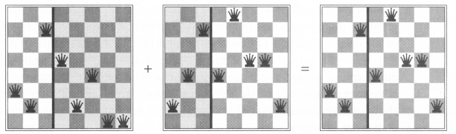

Slide 64
